Slide 1
Quenchbliss Organizational and Motivational Strategy Gary Hobson June 4, 2025 Organizational Behavior
Welcome to my presentation on Quenchbliss’s organizational and motivational strategy, designed to address critical challenges and opportunities as the company grows. As an Organizational Behavior Consultant, I’ve developed this plan based on our SWOT analysis, focusing on high turnover, unclear roles, and international expansion goals. Today, I’ll propose a new organizational structure to enhance efficiency and scalability, alongside motivational strategies to boost employee engagement. These recommendations aim to reduce turnover, support expansion into Jamaica and the Dominican Republic, and align with Quenchbliss’s innovative culture. This presentation is vital for ensuring Quenchbliss’s long-term success in a competitive craft soda market.

Slide 2
Introduction
Purpose: Restructure Quenchbliss and enhance motivation
SWOT Weaknesses:
High turnover in production roles
Unclear roles due to organic structure
SWOT Opportunities:
Expansion into Jamaica and Dominican Republic
Growing craft beverage demand
Overview: Propose matrix structure, three motivational strategies
Quenchbliss faces significant challenges and opportunities as it grows, as identified in our SWOT analysis. High turnover in production roles and unclear responsibilities in the current organic structure hinder efficiency, while expansion into Jamaica and the Dominican Republic offers growth potential in a booming craft beverage market. This presentation proposes a matrix organizational structure to formalize roles and support international operations, addressing turnover and scalability needs. Additionally, we’ll introduce three motivational strategies to boost employee engagement, leveraging motivational theories to ensure retention and performance. These changes are critical to align Quenchbliss’s structure and culture with its ambitious five-year expansion goals.

Slide 3
Proposed Organizational Structure
Matrix Structure Overview:
Combines functional (e.g., production, marketing) and geographic divisions (El Paso, Juarez, Jamaica, Dominican Republic)
Key Features:
Formalized roles and reporting lines
Enhanced coordination for international expansion
Benefits:
Reduces ambiguity, improves efficiency
Scalable for new markets
To address Quenchbliss’s growth needs, I recommend transitioning to a matrix organizational structure, blending functional and geographic divisions. Functional departments, like production and marketing, ensure specialized expertise, while geographic divisions for El Paso, Juarez, Jamaica, and the Dominican Republic support localized operations. This structure formalizes roles, reducing the ambiguity of the current “everybody does everything” approach, a key SWOT weakness. It enhances coordination for international expansion, aligning with the SWOT opportunity of new markets. The matrix balances mechanistic efficiency with flexibility, ensuring Quenchbliss can scale effectively while maintaining innovation (Sophia Learning, n.d., Organizational Designs).

Slide 4
Justification for Matrix Structure
Addresses SWOT Weaknesses:
Reduces turnover by clarifying roles
Mitigates internal friction from strategic shifts
Supports SWOT Opportunities:
Enables expansion into Jamaica and Dominican Republic
Leverages growing craft beverage demand
Why Matrix?
Balances efficiency and flexibility
Aligns with Quenchbliss’s innovation culture
The matrix structure is ideal for Quenchbliss because it directly addresses our SWOT analysis findings. By clarifying roles and reporting lines, it reduces high turnover in production roles, a major weakness, as employees gain clear expectations and career paths. It also mitigates internal friction from strategic shifts by providing structure during expansion. The matrix supports SWOT opportunities, enabling efficient operations in new markets like Jamaica and the Dominican Republic, where craft beverage demand is growing (Beverage Industry, 2025). Its blend of mechanistic efficiency and flexibility aligns with Quenchbliss’s innovative culture, ensuring scalability without sacrificing creativity (Sophia Learning, n.d., Organizational Designs).

Slide 5
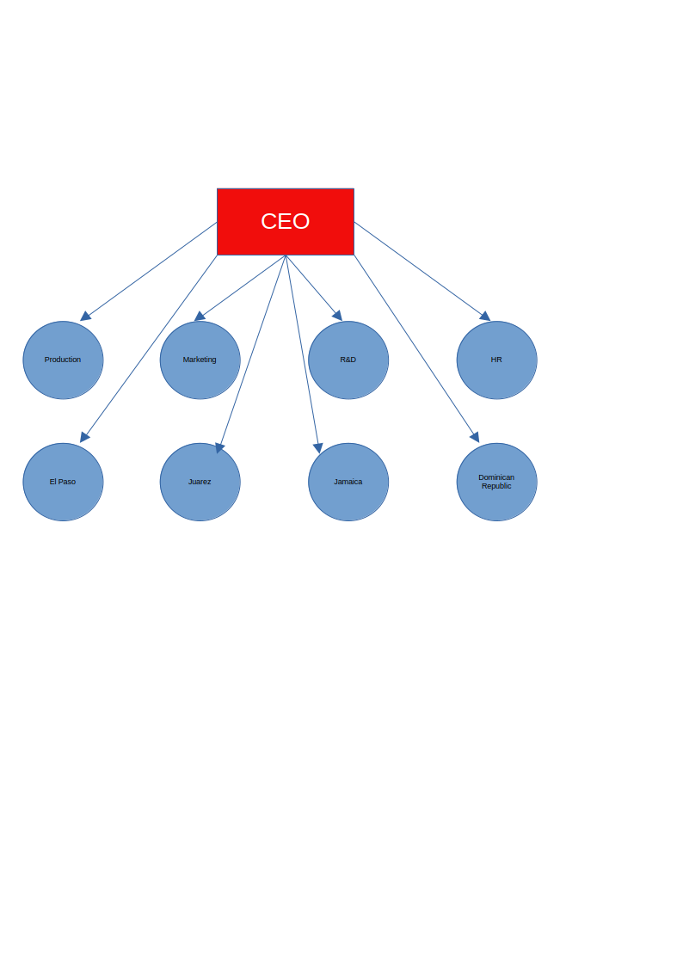
Organizational Structure Graphic
Graphic: Matrix Organizational Chart
Top: CEO
Functional Divisions: Production, Marketing, R&D, HR
Geographic Divisions: El Paso, Juarez, Jamaica, Dominican Republic
Dual reporting lines (functional and geographic managers)
Caption: “Matrix Structure for Quenchbliss’s Global Operations”
This organizational chart illustrates Quenchbliss’s proposed matrix structure, designed for global scalability. The CEO oversees functional divisions Production, Marketing, R&D, and HR ensuring specialized expertise. Geographic divisions for El Paso, Juarez, Jamaica, and the Dominican Republic manage local operations, with dual reporting lines to both functional and geographic managers. This structure clarifies roles, reducing turnover by providing defined responsibilities, and supports expansion by aligning resources across regions. The matrix fosters collaboration, leveraging Quenchbliss’s innovative culture while introducing mechanistic efficiency for growth (Sophia Learning, n.d., Organizational Designs).

Slide 6
Motivational Strategy 1 - Promotion Pathways
Strategy: Define clear promotion pathways with transparent criteria
Motivational Theory: Expectancy Theory
Rationale:
Links effort to performance and promotions (effort-performance expectancy)
Addresses turnover by clarifying career paths (SWOT weakness)
Implementation:
Create job ladders (e.g., production worker to team lead)
Communicate criteria (e.g., sales targets, tenure)
Our first motivational strategy is to define clear promotion pathways, aligning with Expectancy Theory, which posits that employees are motivated when they believe effort leads to performance and valued outcomes. By establishing transparent criteria for advancement, such as sales targets for moving from production worker to team lead, we enhance effort-performance expectancy, addressing the SWOT weakness of high turnover due to unclear roles. This strategy motivates employees to stay and excel, knowing their efforts can lead to promotions. Implementation involves creating job ladders and communicating criteria through training and HR policies. This approach fosters retention and engagement, critical for Quenchbliss’s growth

Slide 7
Motivational Strategy 2 - Recognition Program
Strategy: Implement monthly recognition awards for top performers
Motivational Theory: Herzberg’s Two-Factor Theory
Rationale:
Enhances motivators (recognition, achievement) for intrinsic satisfaction
Reduces turnover by boosting morale (SWOT weakness)
Implementation:
Awards for sales, innovation, teamwork
Public ceremonies to celebrate winners
The second strategy is a monthly recognition program, grounded in Herzberg’s Two-Factor Theory, which distinguishes motivators (e.g., recognition) that drive satisfaction from hygiene factors that prevent dissatisfaction. Recognizing top performers in sales, innovation, or teamwork fosters intrinsic motivation, addressing the SWOT weakness of high turnover by boosting employee morale and engagement. Public award ceremonies amplify the impact, reinforcing Quenchbliss’s clan-like culture. Implementation involves selecting winners based on clear metrics and celebrating them monthly. This strategy enhances retention and aligns with the growing craft beverage market’s need for motivated staff (Mintel, 2024; Sophia Learning, n.d., Fundamentals of Motivation).

Slide 8
Motivational Strategy 3 - Team-Based Incentives
Content:
Strategy: Offer group bonuses for achieving sales/production goals
Motivational Theory: Goal-Setting Theory
Rationale:
Specific, challenging goals increase collaboration and effort
Supports expansion by fostering teamwork (SWOT opportunity)
Implementation:
Bonuses for regional teams meeting targets
Quarterly goal reviews to maintain focus
Our third strategy is team-based incentives, aligned with Goal-Setting Theory, which states that specific, challenging goals enhance performance. Offering group bonuses for regional teams meeting sales or production targets fosters collaboration, addressing the SWOT opportunity of expansion into Jamaica and the Dominican Republic by building cohesive teams. This approach reduces turnover by creating a sense of shared purpose, countering the SWOT weakness of internal friction. Implementation involves setting quarterly goals, tracking progress, and distributing bonuses based on team performance. This strategy drives engagement and supports Quenchbliss’s growth in competitive markets (Beverage Industry, 2025; Sophia Learning, n.d., Fundamentals of Motivation).

Slide 9
Closing Summary
Summary:
Matrix structure clarifies roles, supports global expansion
Motivational strategies (promotion pathways, recognition, incentives) reduce turnover
Benefits:
Enhanced efficiency and scalability
Increased employee engagement and retention
Next Steps:
Pilot matrix structure in El Paso
Launch motivational programs within 6 months
In summary, transitioning to a matrix structure addresses Quenchbliss’s turnover and role ambiguity while enabling expansion into Jamaica and the Dominican Republic. The three motivational strategies—promotion pathways, recognition programs, and team-based incentives—leverage Expectancy Theory, Herzberg’s Two-Factor Theory, and Goal-Setting Theory to boost engagement and retention. These changes enhance efficiency, scalability, and employee satisfaction, positioning Quenchbliss for success in the craft beverage market. Next steps include piloting the matrix structure in El Paso and launching motivational programs within six months. This strategic plan ensures Quenchbliss thrives in a competitive landscape (Sophia Learning, n.d., Managing Change).

Slide 10
References
Beverage Industry. (2025). Craft soda market trends for 2025. Beverage Industry Journal. https://www.beverageindustry.com/articles/97466-state-of-the-beverage-industry-carbonated-soft-drinks-see-volume-declines
Mintel. (2024). Consumer trends in the craft beverage industry. Mintel Reports. https://www.mintel.com/craft-beverage-trends-2024
Sophia Learning. (n.d.). Fundamentals of motivation. Organizational Behavior [MOOC]. Sophia. https://app.sophia.org/course_preview/organizational-behavior/challenge-2-5/1/14502/fundamentals-of-motivation
Sophia Learning. (n.d.). Organizational designs and structures. Organizational Behavior [MOOC]. Sophia. https://app.sophia.org/course_preview/organizational-behavior/challenge-1-2/3/14481/organizational-designs-and-structures
This slide lists the references used to develop our recommendations, ensuring credibility and alignment with Quenchbliss’s needs. The Beverage Industry (2025) and Mintel (2024) reports provide insights into craft soda market trends, supporting our expansion and motivation strategies. Sophia Learning’s tutorials on Fundamentals of Motivation and Organizational Designs and Structures offer theoretical foundations for our matrix structure and motivational plans. These sources, cited in APA format, validate our approach to reducing turnover and scaling operations. Thank you for considering these recommendations to drive Quenchbliss’s future success.

